Slide 1
Bitter on Twitter:
An Offensive Tweet Classification Task
Mareta Masaeva
Mohammadreza Barati
Shima Rahimi

Slide 2
Overview
Pre-processing
Model descriptions
Methods: why and how
Results
Discussion

Slide 3
Pre-processing
Removing noise:
Punctuation (keeping hashtags, apostrophes and double or more !/?/. )
Digits
‘@USER’, ‘&amp’, URLs
stopwords
Converting classic emoticons & emojis to text
Tokenization with TweetTokenizer
Lemmatization (+ POS-tags)
Experimented with: spelling correction & offensive word list

Slide 4
Classic model
Preprocessing: lemmas over stems
Voting Classifier:
Multinomial Naïve Bayes
Bernouilli Naïve Bayes
Logistic Regression
XGBClassifiers (solver: tree/linear)
FeatureUnion: CountVectorizer and TfidfVectorizer

Slide 5
Neural model
Experimented with: RoBERTa, Keras embeddings, Pytorch LSTM
Eventually: Sequential model with Keras Tuner
GloVe word vectors pre-trained on Twitter
Bidirectional LSTM
Global Max Pooling
BatchNormalization
Three pairs of Dropout & Dense layers
Keras Tuner: number of units for LSTM & first Dense layer + learning rate
For competition: RNN with Keras embeddings and global max pooling

Slide 6
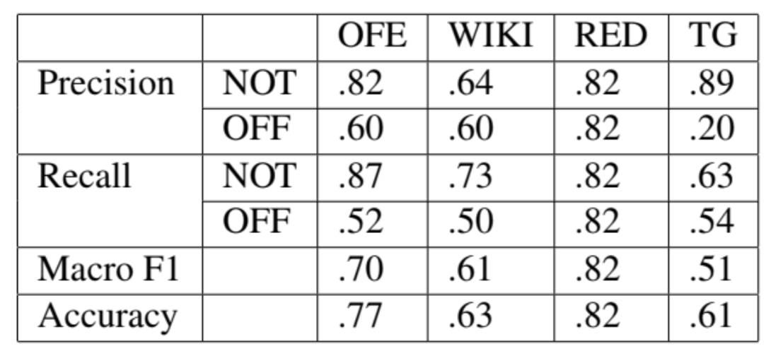
Results: classic model

Slide 7
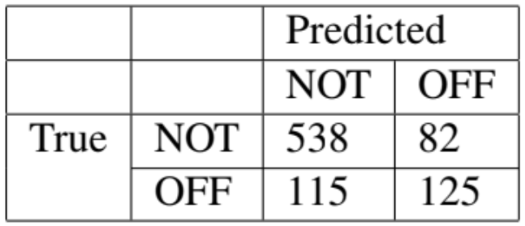
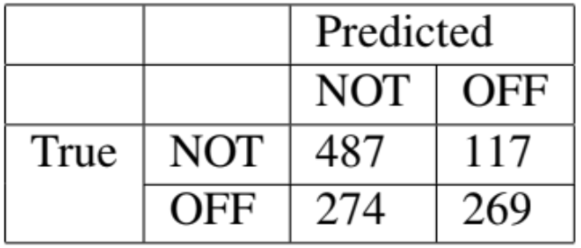
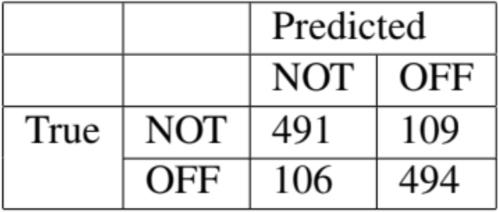
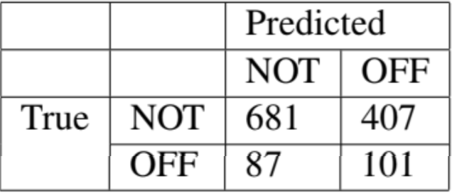
Results: classic model
In-domain Out-domain1
Out-domain 2 Textgain

Slide 8
Error analysis: classic model
Class imbalance: 30% offensive tweets
→ our model is not able to handle this
Naïve Bayes in ensemble: assumes independency of features
→ does not hold in real life
Compared to baseline: reasonable

Slide 9
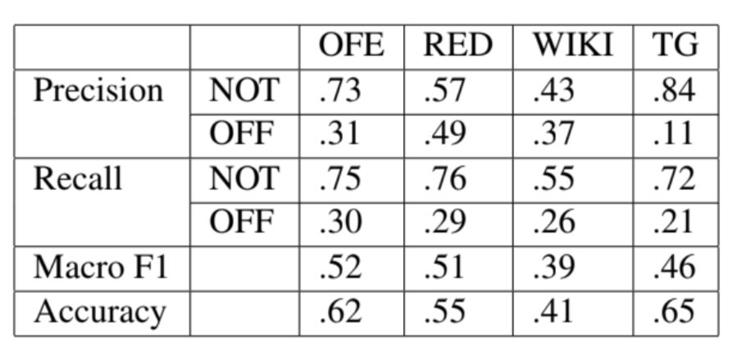
Results: neural model

Slide 10
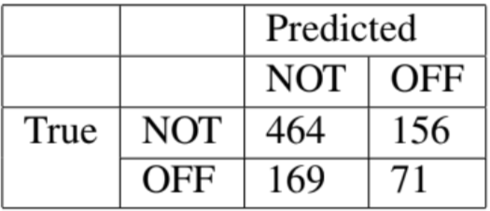
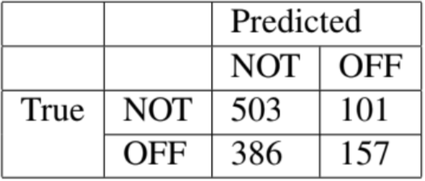
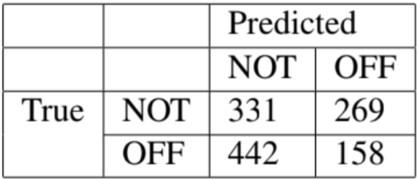
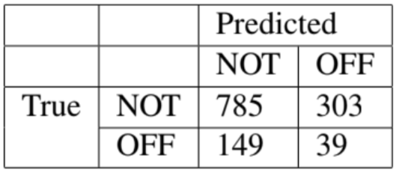
Results: neural model
In-domain Out-domain 1
Out-domain 2 Textgain

Slide 11
Error analysis: neural model
Same issue as in non-neural model: class imbalance
→ TP NOT > TP OFF
Compared to baseline: our model performs much worse
Transformers + GloVe

Slide 12
Conclusion
Should have handled class imbalance more efficiently
But: many experiments, so we learned a lot!

Slide 13
Thank you!

